Slide 1
Calibrating Temperature Sensors
Kenura, Teshan, Kaveesha
8/10/2026
UOC - Physics Department - EIT

Slide 2
Content
Calibrating Temperature Sensors
8/10/2026
1.
Intro & Setup
2.
Data Gathering
3.
Results
3.1.
Two ways to approach the solution
3.2.
Hysteresis?
3.3.
Sensitivity
3.4.
Response Time
4.
Error Analysis
5.
Discussion and conclusion

Slide 3
Calibration of an NTC using a DS18B20, which is a pre-calibrated temperature sensor.
The DS18B20 has 3 pins. Its digital output pin uses an open-drain architecture.
Calibrating Temperature Sensors
8/10/2026
Intro
Notes:
Goal: calibrate an NTC thermistor against the DS18B20 (reference, ±0.5 °C), then measure how fast the thermistor responds. The DS18B20 talks over 1-Wire: one data pin plus ground; the data pin is open-drain.

Slide 4
Setup
Calibrating Temperature Sensors
8/10/2026
1.
The circuit is a simple voltage divider with the NTC connected on one side of the GND.
A 3.3 kΩ resistor is used to keep the output within the measurable range.
2.
Both the DS18B20 and the NTC are immersed in a water bath, close together.
The bath is continuously stirred.
3.
Middle node of the voltage divider setup is connected to an Arduino ADC pin.
The data wire of the DS18B20 is connected to a digital pin.
Notes:
NTC + fixed resistor form a voltage divider read by the Arduino ADC (10-bit, 0-1023). The 3.3 kOhm value is as stated on the slide; confirm it against the lab sheet before presenting.

Slide 5
Data Gathering
Calibrating Temperature Sensors
8/10/2026
Next steps
Sample Gathering
Three setups: 3 × DS18B20 and 3 × NTC at 3 random positions in the same water bath.
Treatments
Ice cooled the bath; a hot plate heated it. Each member monitored the 3 device pairs.
Monitoring
Temperature vs time and vs raw ADC were plotted. Each run was saved as a log and a CSV.
Response Time
NTC moved from a room-temperature bath to an ice bath until 0 °C, then back.
Notes:
Three valid runs were used for calibration (1 heating, 2 cooling); other runs had a stuck ADC channel. The response-time test is a separate step test: room-temperature water to ice bath and back.

Slide 6
Two ways to approach the solution
Calibrating Temperature Sensors
8/10/2026
Results
Data used
3 valid runs: 1 heating, 2 cooling
5319 samples from 0 to 98 °C
12 rows removed: 3 empty, 9 outliers (beyond 2.5σ)
Heating and cooling runs were fitted separately first. Then we compared an empirical fit with a physical model.
Polynomial fit
NTC β-model
Cubic is best: RMSE 0.35 °C (heating) and 0.55 °C (cooling).
ln r vs 1/T is a straight line: β = 3965 K, RMSE 0.60 °C with 2 parameters.
Notes:
Outliers are points more than 2.5 standard deviations (1.38 °C) from the cooling fit. Data audit: heating 1079 logged -> 1078 used; cooling 4252 logged -> 4241 used.

Slide 7
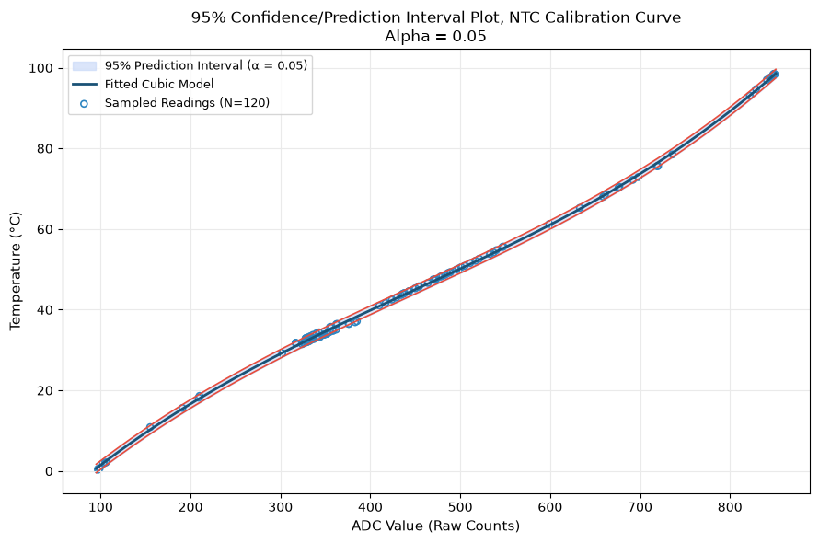
Polynomial fit
Calibrating Temperature Sensors
8/10/2026
Global cubic: heating and cooling data combined
2.3 → 0.35 °C
Heating RMSE, straight line vs cubic
0.54 °C
Global cubic RMSE (N = 5319)
±1.06 °C
Mean 95 % prediction half-width
T = 1.869×10⁻⁷ a³ − 2.495×10⁻⁴ a² + 0.2134 a − 17.558, a = ADC count
Notes:
Degree 1-3 polynomials were fitted to T vs ADC. The cubic cuts the straight-line S-shaped error (up to about 4 °C) to an RMSE of about 0.5 °C. Global fit: R² = 0.999, RMSE 0.54 °C. The 95 % prediction band is a rough guide: residuals are correlated in time (Durbin-Watson ~0.02), so the quoted standard errors are too small. Do not use the cubic outside 0-98 °C.

Slide 8
NTC β-model: from circuit to temperature
Calibrating Temperature Sensors
8/10/2026
1
2
3
4
Divider
Arrhenius
Linear form
Runtime
r = (1023 − ADC) / ADC
R ∝ exp(β / T)
ln r = β · (1/T) + c
T = 1 / (A ln r + B) − 273.15
r = R(NTC) / R(fixed). Supply drift cancels.
Carriers jump the band gap: β = Eg / 2kB
The slope of ln r vs 1/T gives β
A = 1/β; used on the Arduino
Notes:
Because the ADC reference is the supply rail, the reading is ratiometric: ADC = 1023 * Rf / (Rntc + Rf). Rearranging gives r = (1023 - ADC)/ADC. Arrhenius: R(T) = R0 exp[beta(1/T - 1/T0)], T0 = 298.15 K, beta = Eg / 2kB. Taking ln gives a straight line in 1/T; A = 1/beta and B = -c/beta give the formula used in the logger.

Slide 9
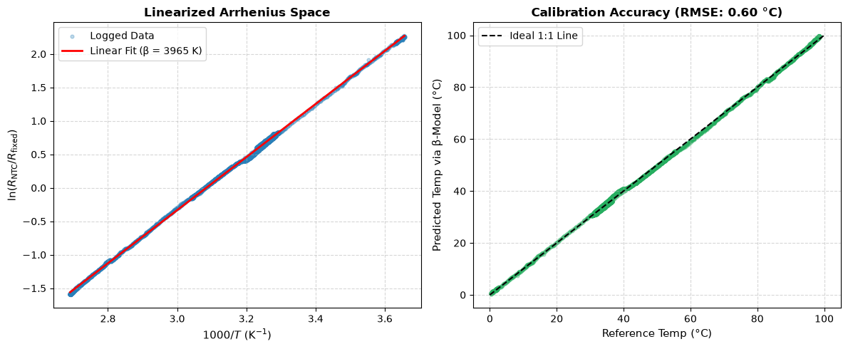
β-model validation
Calibrating Temperature Sensors
8/10/2026
A straight line of ln r vs 1/T gives β = 3965.3 K with R² = 0.9993 and RMSE 0.60 °C, from only two parameters.
Notes:
Left: linearised Arrhenius plot with the straight-line fit. Right: predicted vs reference temperature (RMSE 0.598 °C). Two parameters (beta and r0) versus four for the cubic.

Slide 10
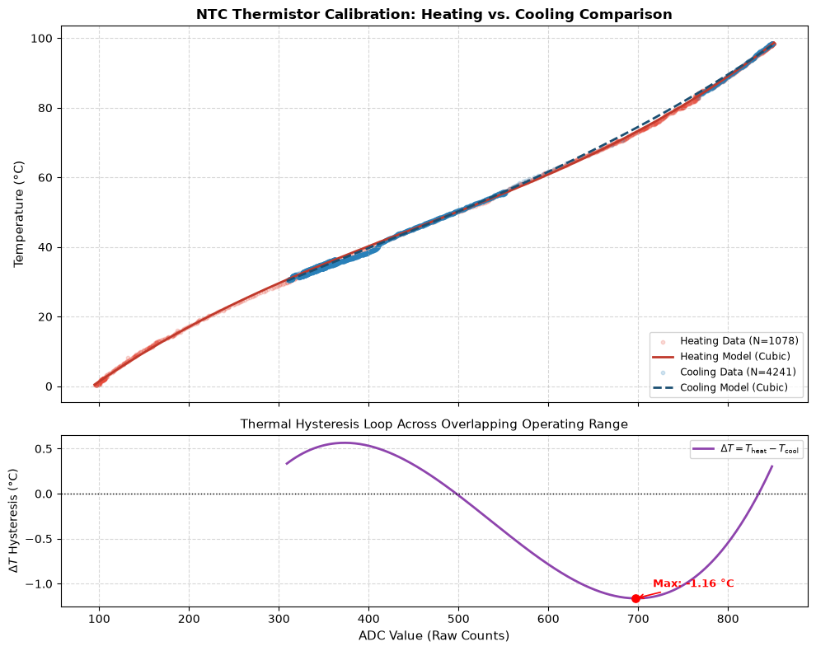
Hysteresis?
Calibrating Temperature Sensors
8/10/2026
1.16 °C
Largest heating vs cooling gap (mean 0.61 °C)
Likely causes
Thermal lag between the probes
Subtracting two cubics
Bath temperature gradients
The gap is below the reference uncertainty, so we do not claim real hysteresis.
Notes:
Compared the heating and cooling cubic fits over the shared ADC range 309-849: max gap 1.163 °C (1.16 % of full scale), mean 0.608 °C. Causes: (1) different thermal time constants of the NTC bead and the reference probe; (2) the difference of two cubics is always a smooth wave crossing zero (near ADC 500), so part of it is a maths effect; (3) bath gradients if stirring is poor. The mean gap is smaller than the reference uncertainty.

Slide 11
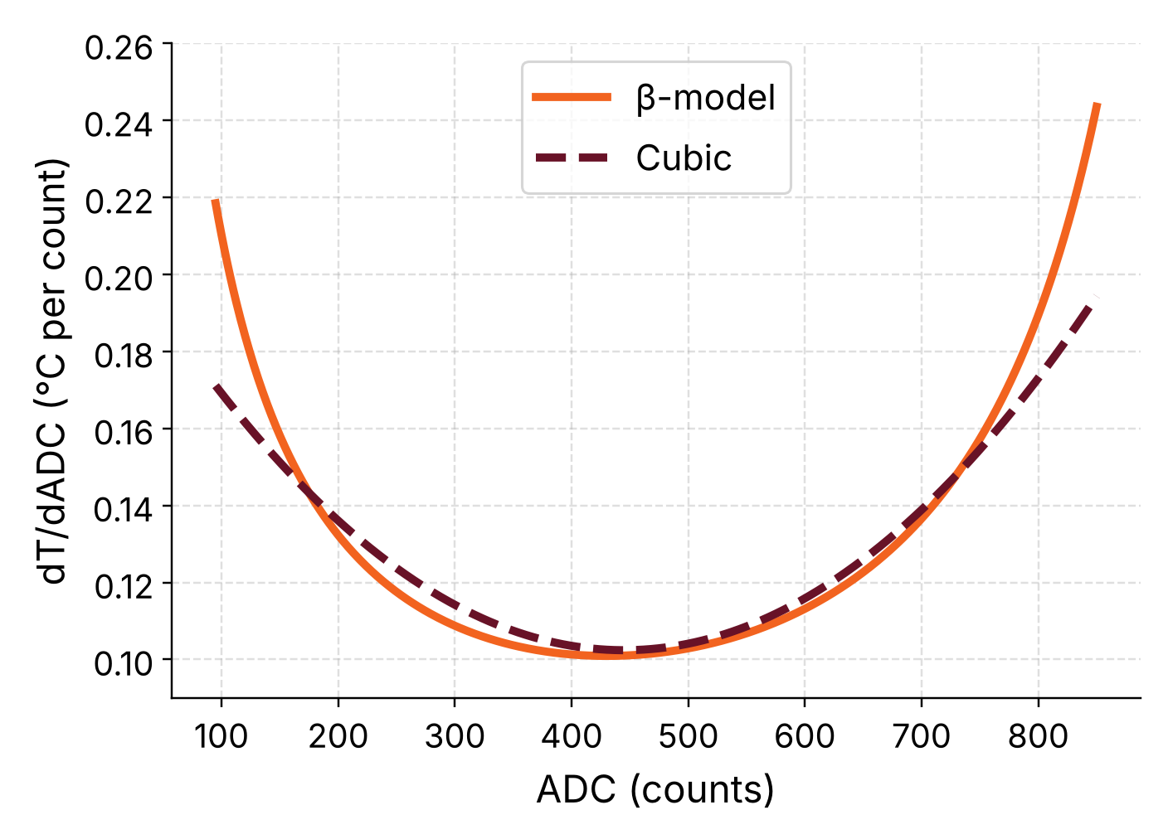
Sensitivity
Calibrating Temperature Sensors
8/10/2026
dT/dADC in °C per count. Smaller means finer resolution.
≈ 0.10 °C
Per count near mid-range (ADC ≈ 440)
0.17–0.25 °C
Per count at the ends of the range
Both models agree: best in the middle, coarser at both ends.
Notes:
Ranges from the notebook: cubic 0.102-0.195 °C/count, beta-model 0.101-0.245 °C/count. This plot was redrawn for the slide from the fitted coefficients (cubic and beta-model) with larger fonts; minimum/maximum agree with the notebook output. One ADC count is the smallest step the logger can resolve, so this is also the quantisation step in °C.

Slide 12
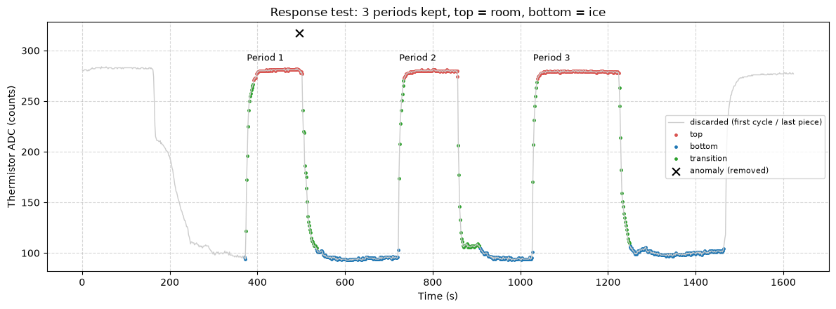
Response time: the step test
Calibrating Temperature Sensors
8/10/2026
NTC moved between room-temperature water and an ice bath
3 clean periods kept; 1 spike removed
Each step fitted with a delayed first-order model
Notes:
Response log from the second configuration. Anomaly: one spike at t = 495.8 s removed. The first cycle and the last, unfinished piece were dropped, leaving 3 periods (top = room, bottom = ice). Red = room-temperature plateau, blue = ice plateau, green = transition. The model is Newton's law of cooling with a delay: flat until t0, then exponential.

Slide 13
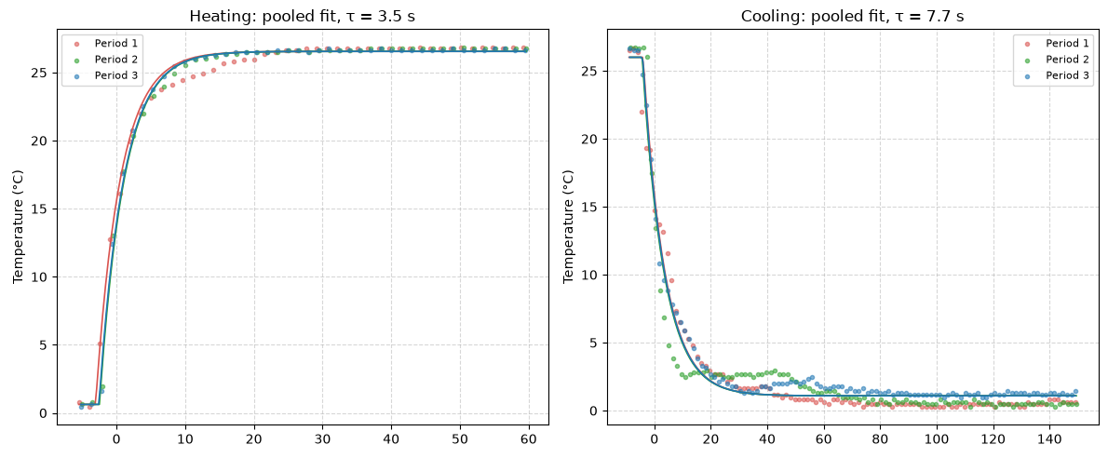
Response time: τ from the fit
Calibrating Temperature Sensors
8/10/2026
Pooled fit of 3 periods, cubic calibration (β-model: τ = 3.3 s and 8.6 s).
3.5 s
7.7 s
7.8 | 16.8 s
0.47 | 0.92 °C
τ heating, ±0.3 s
τ cooling, ±2.2 s
10–90 % time, heating | cooling
Fit RMSE, heating | cooling
Notes:
Pooled fit: one tau, start and end temperature shared by the 3 periods, own delay per period. Cubic calibration: heating tau = 3.54 s (jackknife SE 0.32 s), cooling tau = 7.66 s (SE 2.17 s). beta-model: 3.32 s and 8.61 s. 10-90 % times 7.78 s and 16.83 s. The heating fit is good; the cooling fit leaves systematic residuals (up to a few degrees near the start) and a larger uncertainty, so treat 7.7 s as approximate. The standard errors come from leaving one of only 3 periods out. We did not test why cooling is slower.

Slide 14
Error Analysis
Calibrating Temperature Sensors
8/10/2026
Uncertainty
Reference
DS18B20 is ±0.5 °C. We assume about ±1 °C in practice, so smaller errors cannot be proven.
ADC steps
10-bit ADC: each count is 0.10 to 0.25 °C, coarsest at both ends of the range.
±1.06 °C
Mean 95 % prediction half-width of the global cubic
Fit
RMSE 0.54 °C (cubic), 0.60 °C (β-model). Residuals are correlated, so standard errors are optimistic.
Process
Thermal lag and bath gradients. Self-heating was not quantified. Only 3 usable runs, 0–98 °C.
Notes:
Reference: DS18B20 spec is ±0.5 °C (-10 to +85 °C); the report assumes about ±1 °C in practice. ADC step: the sensitivity dT/dADC (0.10-0.25 °C per count) is the quantisation step. Fit: Durbin-Watson ~0.02 for cooling, so standard errors are too small; the 95 % prediction band is a rough guide. Process: apparent hysteresis up to 1.16 °C is attributed to thermal lag/gradients. Self-heating from the divider current was not measured here. No datasheet beta value was available for a percent-error comparison.

Slide 15
Discussion and conclusion
Calibrating Temperature Sensors
8/10/2026
Two models
Cubic: 4 parameters, RMSE 0.54 °C. β-model: 2 parameters, RMSE 0.60 °C. Both are within the ±1 °C reference.
Dynamics
τ ≈ 3.5 s heating, 7.7 s cooling. The heating/cooling gap (about 0.6 °C) is below the reference uncertainty.
Recommendation
Use the β-model as the main calibration. Keep the cubic for the lowest error inside 0 to 98 °C.
Notes:
Cubic: empirical, marginally better inside the measured range. Beta-model: physical, half the parameters; its physical basis should make it safer outside 0-98 °C, but that was not tested with our data. One calibration serves both heating and cooling because the 0.6 °C mean gap is below the reference uncertainty. Limits: 3 usable runs, 0-98 °C, reference only ±0.5 °C.

